Slide 1

Contemporary Business Mathematics with Canadian Applications
Eleventh Canadian Edition
Chapter 1
Review of Arithmetic
Copyright © 2018 Pearson Canada Inc.
Notes:
If this PowerPoint presentation contains mathematical equations, you may need to check that your computer has the following installed:
1) MathType Plugin
2) Math Player (free versions available)
3) NVDA Reader (free versions available)

Slide 2
Objectives
Simplify arithmetic expressions using the basic order of operation
Determine equivalent fractions and convert fractions to decimals
Through problem solving, compute simple arithmetic and weighted averages
Determine gross earnings for employees remunerated by the payment of salaries, hourly wages, or commissions
Through problem solving, compute GST, HST, PST, sales taxes, and property taxes

Slide 3
Basic Order of Operations (BEDMAS) (1 of 3)
Perform all operations inside a bracket first (operations inside the bracket must be performed in the proper order)
Perform all exponents
Perform multiplication and division in the order as they appear from the left to right
Perform addition and subtraction in order as they appear from left to right
B | E | D | M | A | S
Brackets | Exponents | Division | Multiplication | Addition | Subtraction

Slide 4
Basic Order of Operations (BEDMAS) (2 of 3)
Examples Using BEDMAS
(9 − 4) × 2 = 5 × 2 = 10 → work inside the bracket first
9 − 4 × 2 = 9 − 8 = 1 → do multiplication before subtraction
18 ÷ 6 + 3 × 2 = 3 + 6 = 9 → do multiplication and division before adding
(13 + 5) ÷ 6 − 3 = 18 ÷ 6 − 3 = 3 − 3 = 0 → work inside the bracket first, then do division before subtraction
18 ÷ (6 + 3) × 2 = 18 ÷ 9 × 2 = 2 × 2 = 4 → work inside the bracket first, then do division and multiplication in order
18 ÷ (3 × 2) + 3 = 18 ÷ 6 + 3 = 3 + 3 = 6 → work inside the bracket first, then divide before adding

Slide 5
Basic Order of Operations (BEDMAS) (3 of 3)
Examples Using BEDMAS
8(9 − 4) − 4(12 − 5) = 8(5) − 7(4) = 40 − 28 = 12 → work inside the brackets first, then multiply before subtracting
(12 − 4)/(6 − 2) = (12 − 4) ÷ (6 − 2) = 8 ÷ 4 = 2 → he fraction line indicates brackets as well as division
128 ÷ (2 × 4)^2 − 3 = 128 ÷ 8^2 − 3 = 128 ÷ 64 − 3 = 2 − 3 = − 1 → work inside the bracket first, do the exponent, then divide before subtracting
128 ÷ (2 × 4^2 ) − 3 = 128 ÷ (2 × 16) − 3 = 128 ÷ 32 − 3 = 4 − 3 = 1 → start inside the bracket and do the exponent first, then multiply, then divide before subtracting

Slide 6
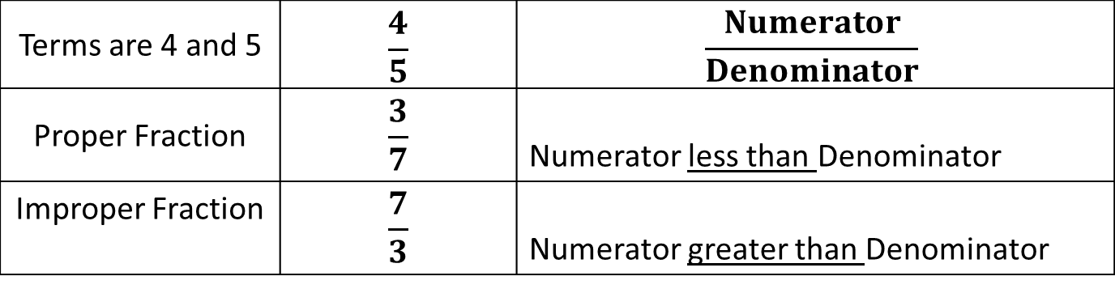
Common Fractions
Terms are 4 and 5 | $$\frac{4}{5}$$ | $$\frac{Numerator}{Denominator}$$
Proper Fraction | $$\frac{3}{7}$$ | Numerator less than Denominator
Improper Fraction | $$\frac{7}{3}$$ | Numerator greater than Denominator

Slide 7
Equivalent Fractions (1 of 2)
Change terms without changing value!
Equivalent fractions in higher terms;
Obtained by multiplying both the numerator and the denominator of a fraction by the same number.
For any fraction, we can obtain an unlimited number of equivalent fractions in higher terms.
Equivalent fractions in lower terms;
Obtained if both the numerator and denominator of a fraction are divisible by the same number or numbers.
The process of obtaining such equivalent fractions is called reducing to lower terms.

Slide 8
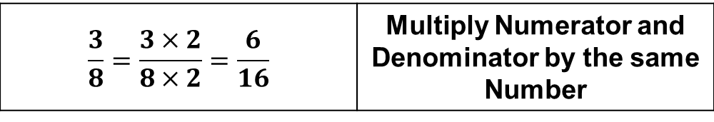
Equivalent Fractions (2 of 2)
Change terms without changing value.
$$\frac{3}{8}=\frac{3×2}{8×2}=\frac{6}{16}$$ | Multiply Numerator and Denominator by the same Number
Value is the same as 3/8

Slide 9
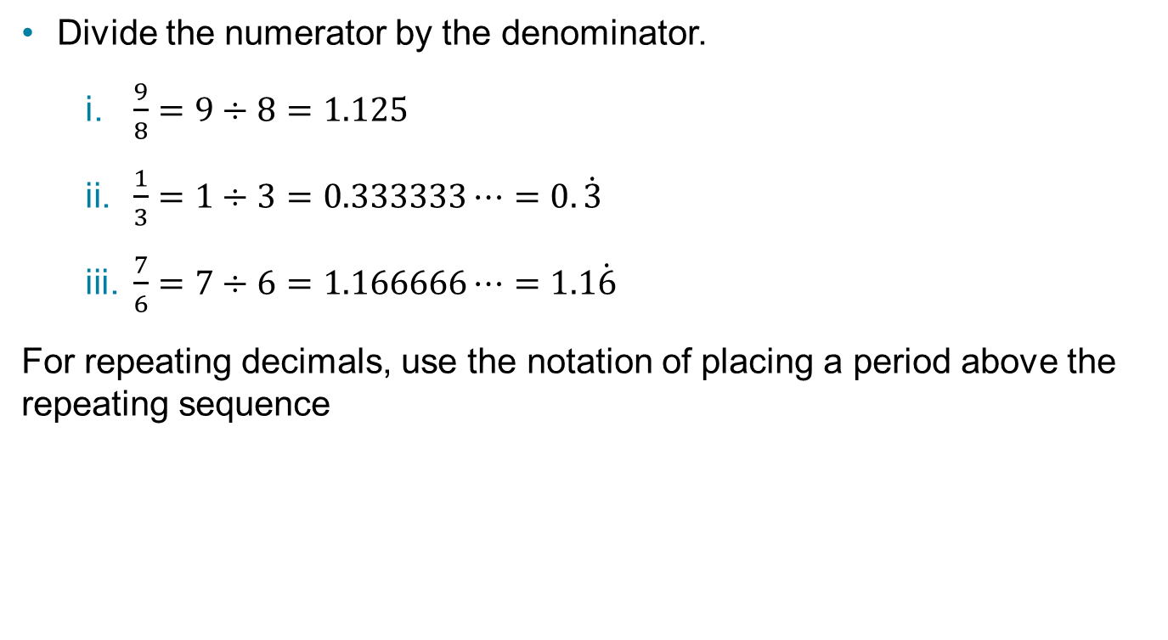
Converting Common Fractions into Decimal Form
Divide the numerator by the denominator.
$\frac{9}{8}=9÷8=1.125$
$\frac{1}{3}=1÷3=0.333333⋯=0.\dot{3}$
$\frac{7}{6}=7÷6=1.166666⋯=1.1\dot{6}$
For repeating decimals, use the notation of placing a period above the repeating sequence

Slide 10
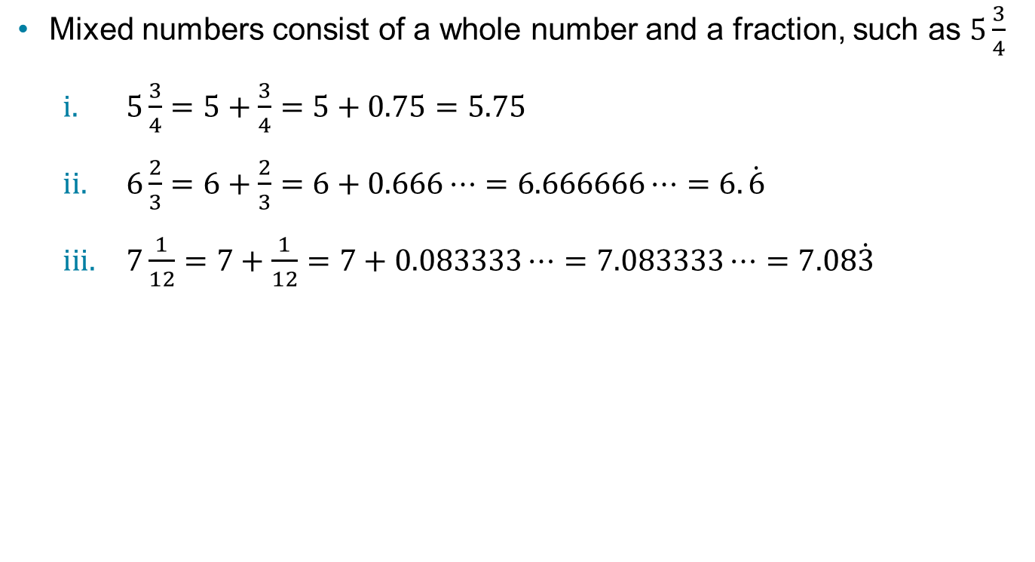
Converting a Mixed Number to Decimal Form
Mixed numbers consist of a whole number and a fraction, such as $5\frac{3}{4}$
$5\frac{3}{4}=5+\frac{3}{4}=5+0.75=5.75$
$6\frac{2}{3}=6+\frac{2}{3}=6+0.666⋯=6.666666⋯=6.\dot{6}$
$7\frac{1}{12}=7+\frac{1}{12}=7+0.083333⋯=7.083333⋯=7.08\dot{3}$

Slide 11
Rounding (1 of 3)
If the first digit in the group of decimal digits that is to be dropped is the digit 5 or 6 or 7 or 8 or 9, the last digit retained is increased by 1
If the first digit in the group of decimal digits that is to be dropped is the digit 0 or 1 or 2 or 3 or 4, the last digit retained is left unchanged

Slide 12
Rounding (2 of 3)
7.384 → $7.38 → drop the digit 4
7.385 → $7.39 → round the digit 8 up to 9
12.9448 → $12.94 → discard
9.32838 → $9.33 → round the digit 2 up to 3

Slide 13
Rounding (3 of 3)
24.8975 → $24.90 → round the digit 9 up to 0; this requires rounding 89 to 90
1.996 → $2.00 → round the second digit 9 up to 0; this requires rounding 1.99 to 2.00
3199.99833 → $3200.00 → round the second digit 9 up to 0; this requires rounding 3199.99 to 3200.00

Slide 14
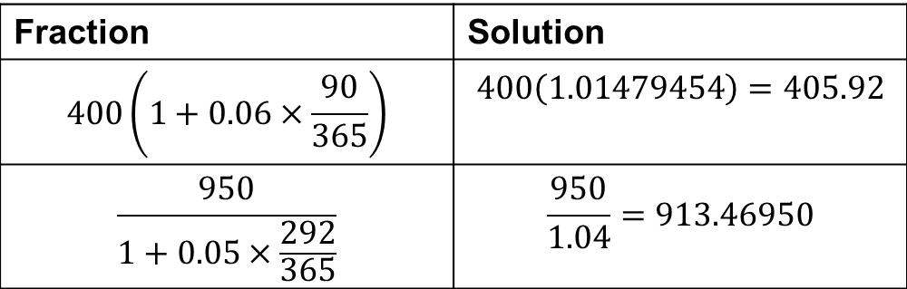
Complex Fractions (1 of 2)
Complex fractions are mathematical expressions containing one or more fractions in the numerator or denominator or both.
Fraction | Solution
$$400\left(1+0.06×\frac{90}{365}\right)$$ | $$400\left(1.01479454\right)=405.92$$
$$\frac{950}{1+0.05×\frac{292}{365}}$$ | $$\frac{950}{1.04}=913.46950$$

Slide 15
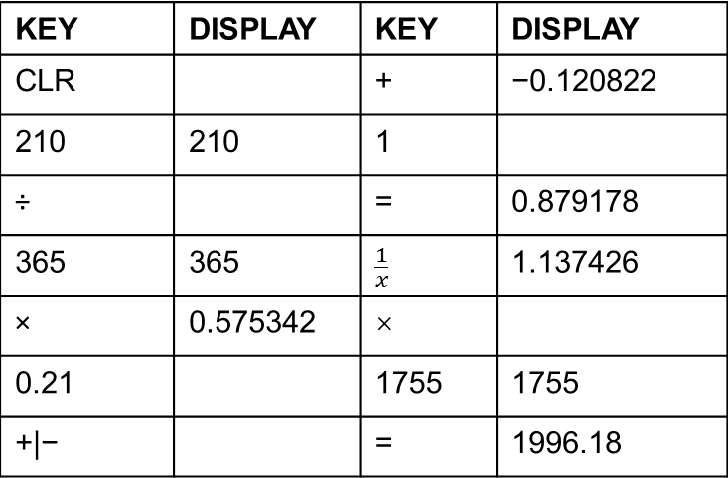
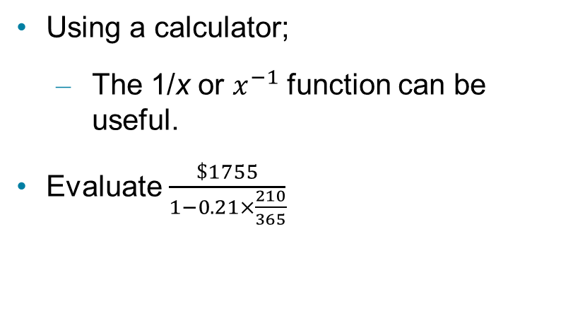
Complex Fractions (2 of 2)
Using a calculator;
The 1/x or $x^{−1}$ function can be useful.
Evaluate $\frac{\$1755}{1−0.21×\frac{210}{365}}$
KEY | DISPLAY | KEY | DISPLAY
CLR |  | + | −0.120822
210 | 210 | 1
÷ |  | = | 0.879178
365 | 365 | $$\frac{1}{x}$$ | 1.137426
× | 0.575342 | ×
0.21 |  | 1755 | 1755
+|− |  | = | 1996.18

Slide 16
The Meaning of Percent
Percent means “per hundred”
The symbol % means “parts of one hundred”
Percent | Fraction | Decimal
17% | 17/100 | 0.17
0.8% | 0.8/100 = 8 /1,000 | 0.008
55% | 55/100 | 0.55
215% | 215/100 | 2.15
0.75% | 0.75/100 = 75/10,000 | 0.0075
3/8 % | 0.375/100 = 375/100,000 | 0.00375

Slide 17
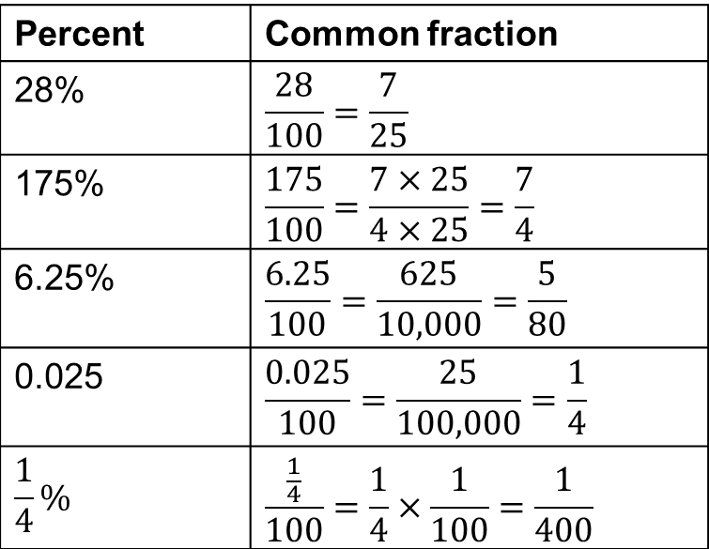
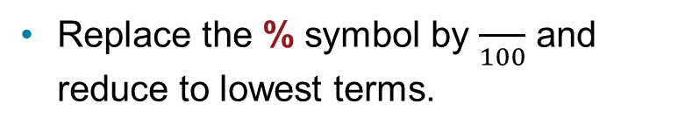
Changing Percents to Common Fractions
Replace the % symbol by $\frac{}{100}$ and reduce to lowest terms.
Percent | Common fraction
28% | $$\frac{28}{100}=\frac{7}{25}$$
175% | $$\frac{175}{100}=\frac{7×25}{4×25}=\frac{7}{4}$$
6.25% | $$\frac{6.25}{100}=\frac{625}{10,000}=\frac{5}{80}$$
0.025 | $$\frac{0.025}{100}=\frac{25}{100,000}=\frac{1}{4}$$
$$\frac{1}{4}\%$$ | $$\frac{\frac{1}{4}}{100}=\frac{1}{4}×\frac{1}{100}=\frac{1}{400}$$

Slide 18
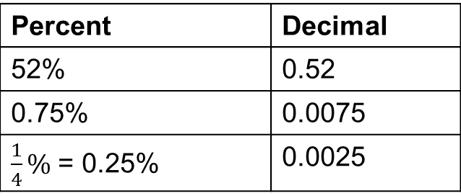
Changing Percents to Decimals
Drop the % symbol and move the decimal two places to the left.
Or drop the decimal and divide by 100
Percent | Decimal
52% | 0.52
0.75% | 0.0075
$\frac{1}{4}\%$ = 0.25% | 0.0025

Slide 19
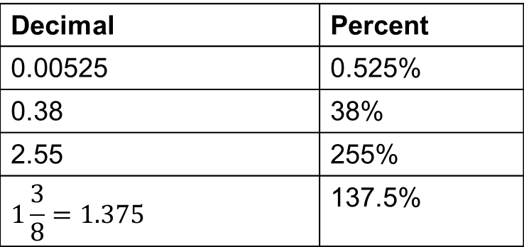
Changing Decimals to Percents
Move the decimal two places to the right and add the % symbol.
Decimal | Percent
0.00525 | 0.525%
0.38 | 38%
2.55 | 255%
$$1\frac{3}{8}=1.375$$ | 137.5%

Slide 20
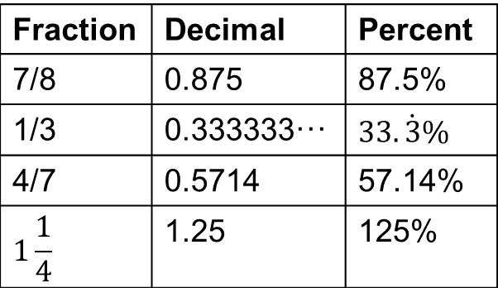
Changing Fractions to Percents
First convert the fraction to a decimal, then convert the decimal to percent.
Fraction | Decimal | Percent
7/8 | 0.875 | 87.5%
1/3 | 0.333333··· | $$33.\dot{3}\%$$
4/7 | 0.5714 | 57.14%
$$1\frac{1}{4}$$ | 1.25 | 125%

Slide 21
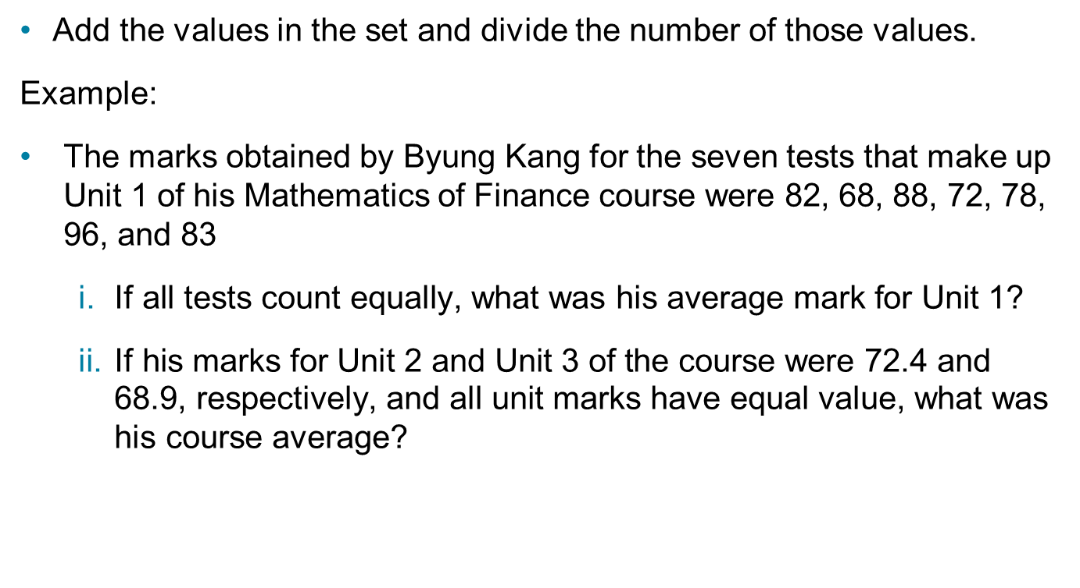
The Arithmetic Average or Mean (1 of 2)
Add the values in the set and divide the number of those values.
Example:
The marks obtained by Byung Kang for the seven tests that make up Unit 1 of his Mathematics of Finance course were 82, 68, 88, 72, 78, 96, and 83
$\text{If} \text{all} \text{tests} \text{count} \text{equally}\text{, }\text{what} \text{was} \text{his} \text{average} \text{mark} \text{for} \text{Unit}\text{ 1?}$
$\text{If} \text{his} \text{marks} \text{for} \text{Unit}\text{ 2 }\text{and} \text{Unit}\text{ 3 }\text{of} \text{the} \text{course} \text{were}\text{ 72.4 }\text{and}\text{ 68.9, }\text{respectively}\text{, }\text{and} \text{all} \text{unit} \text{marks} \text{have} \text{equal} \text{value}\text{, }\text{what} \text{was} \text{his} \text{course} \text{average}\text{?}$

Slide 22
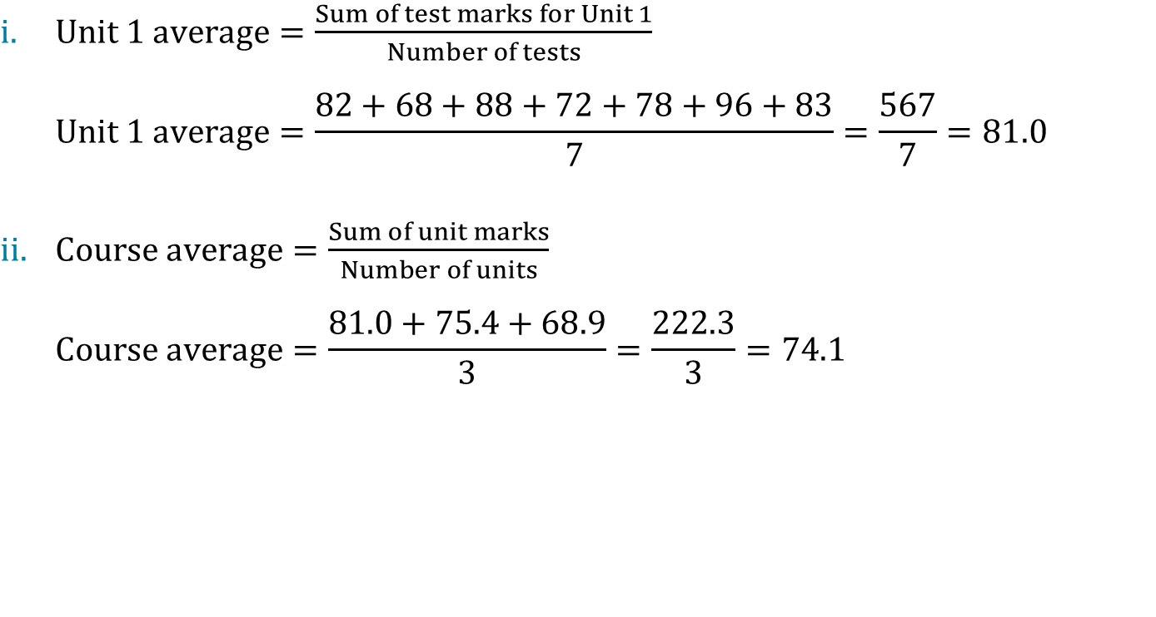
The Arithmetic Average or Mean (2 of 2)
$Unit 1 average=\frac{Sum of test marks for Unit 1}{Number of tests}$
$$Unit 1 average=\frac{82+68+88+72+78+96+83}{7}=\frac{567}{7}=81.0$$
$Course average=\frac{Sum of unit marks}{Number of units}$
$$Course average=\frac{81.0+75.4+68.9}{3}=\frac{222.3}{3}=74.1$$

Slide 23
Weighted Average
Use a weighting factor to indicate the number of items in a group or the relative importance of data items.
multiply each item by the numbers involved or by a weighting factor representing its importance.

Slide 24
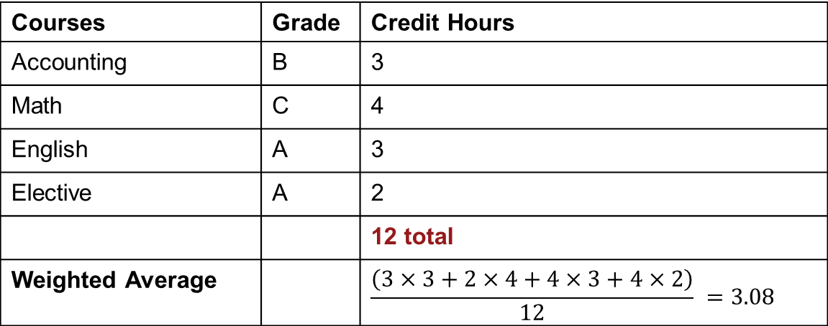
Weighted Average Grade
Weights
A = 4
B = 3
C = 2
D = 1
Courses | Grade | Credit Hours
Accounting | B | 3
Math | C | 4
English | A | 3
Elective | A | 2
 |  | 12 total
Weighted Average |  | $$\frac{\left(3×3+2×4+4×3+4×2\right)}{12} =3.08$$

Slide 25
Applications
PAYROLL

Slide 26
Payroll Applications Salaries (1 of 4)
Compensation of employees by salary is usually on a monthly or a yearly basis.
monthly salaried personnel get paid either monthly or semi-monthly.
personnel on a yearly salary basis may get paid monthly, semi-monthly, every two weeks, weekly.
special schedules such are used by some boards of education to pay their teachers.
If salary is paid weekly or every two weeks, the year is assumed to consist of exactly 52 weeks.

Slide 27
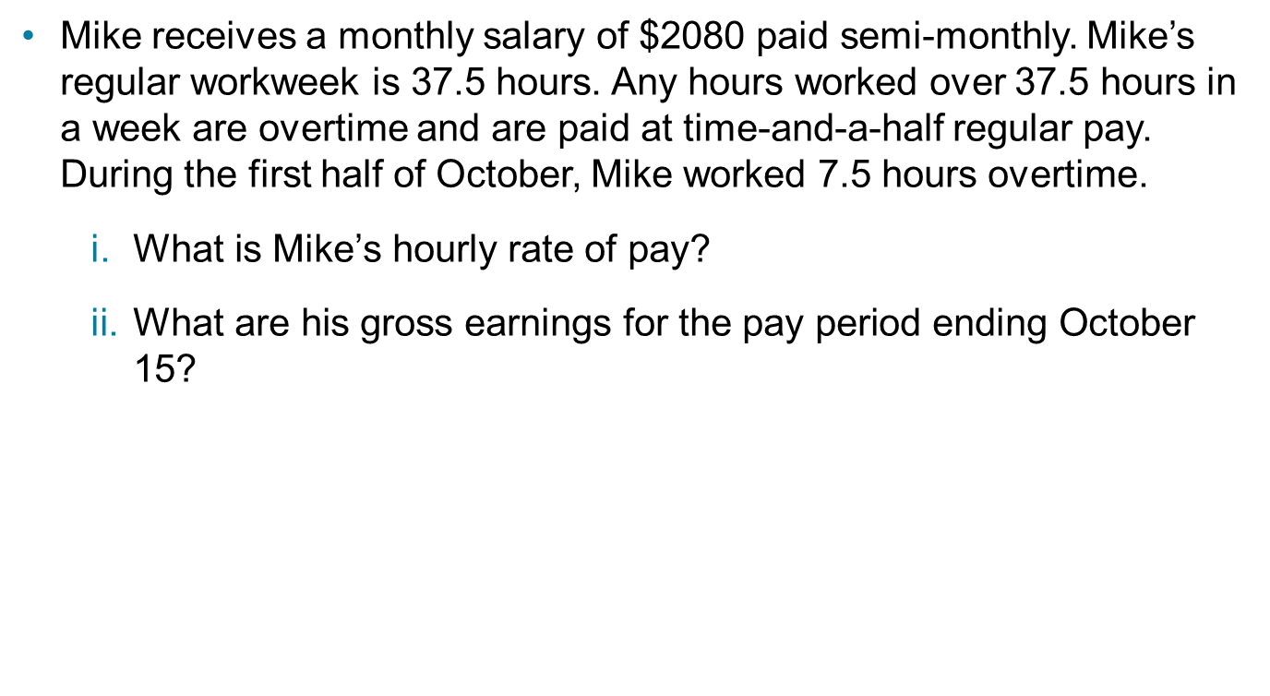
Payroll Applications Salaries (2 of 4)
Mike receives a monthly salary of $2080 paid semi-monthly. Mike’s regular workweek is 37.5 hours. Any hours worked over 37.5 hours in a week are overtime and are paid at time-and-a-half regular pay. During the first half of October, Mike worked 7.5 hours overtime.
$\text{What} \text{is} \text{Mike}\text{’}\text{s} \text{hourly} \text{rate} \text{of} \text{pay}\text{?}$
$\text{What} \text{are} \text{his} \text{gross} \text{earnings} \text{for} \text{the} \text{pay} \text{period} \text{ending} \text{October}\text{ 15?}$

Slide 28
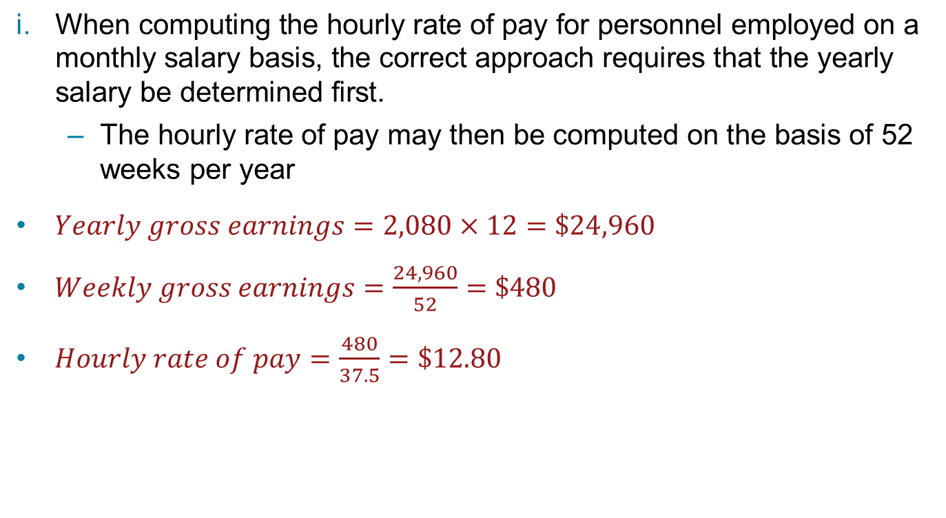
Payroll Applications Salaries (3 of 4)
$\text{When} \text{computing} \text{the} \text{hourly} \text{rate} \text{of} \text{pay} \text{for} \text{personnel} \text{employed} \text{on} \text{a} \text{monthly} \text{salary} \text{basis}\text{, }\text{the} \text{correct} \text{approach} \text{requires} \text{that} \text{the} \text{yearly} \text{salary} \text{be} \text{determined} \text{first}\text{.}$
$\text{The} \text{hourly} \text{rate} \text{of} \text{pay} \text{may} \text{then} \text{be} \text{computed} \text{on} \text{the} \text{basis} \text{of}\text{ 52 }\text{weeks} \text{per} \text{year}$
$Yearly gross earnings=2,080×12=\$24,960$
$Weekly gross earnings=\frac{24,960}{52}=\$480$
$Hourly rate of pay=\frac{480}{37.5}=\$12.80$

Slide 29

Payroll Applications Salaries (4 of 4)
$\begin{matrix}Regular semi−monthly \\ gross earnings\end{matrix}=\frac{2,080}{2}=\$1,040$
$Overtime pay=7.5×12.80×1.5=\$144$
$\begin{matrix}Total gross earnings \\ per pay period\end{matrix}=1,040+144=\$1,184$

Slide 30
Commission (1 of 2)
Persons engaged in the buying and selling functions of a business are often compensated by a commission.
Straight commission
Usually calculated as a percent of net sales for a given time period
Net sales are the difference between the gross sales for the time period and any sales returns and allowances, or sales discounts.
Graduated commission
Usually involves paying an increasing percent for increasing sales levels during a given time period.
Salary plus commission
A method that guarantees a minimum income per pay period to the salesperson.
The rate of commission in such cases is either at a lower rate or is not paid until a minimum sales level (called a quota) for a time period has been reached.

Slide 31
Commission (2 of 2)
Sales personnel on commission often have a drawing account.
The salesperson may withdraw funds from such an account in advance to meet business and personal expenses.
Money advanced is deducted from the commission earned when the salesperson is paid.

Slide 32
Straight Commission
Monthly sales | $25,000
Monthly commission rate | 6%
Monthly commission | $25,000 × 6% = $1,500

Slide 33
Graduated Commission
Rate | $50,000 monthly sales
5% | First $10,000
6% | Next $10,000
9% | Above $20,000
Calculations
0.05 × 10,000 | $500
0.06 × 10,000 | $600
0.09 × (50,000 – 20,000) = 0.09 × 30,000 | $2,700
Commission | $3,800

Slide 34

Wages
Compensation paid to hourly rated employees.
Gross earnings are calculated by multiplying the number of hours worked by the hourly rate of pay plus any overtime pay.
$$Gross earnings=\begin{matrix}Gross pay \\ for workweek\end{matrix}+\begin{matrix}Overtime \\ pay\end{matrix}$$

Slide 35
Gross Pay
The most common regular workweek is 40 hours.
If no agreement exists, federal or provincial employment standards legislation provides for a maximum number of hours per week, such as 44 hours for most employers.
Any hours over the set maximum must be paid at least at time-and-a-half the regular hourly rate (overtime).

Slide 36
Overtime
When overtime is involved, gross earnings can be calculated by either of two methods.
Method A
Add overtime pay to the gross pay for a regular workweek.
Method B
Overtime excess (overtime premium) is computed separately and added to gross earnings for all hours (including the overtime hours) at the regular rate of pay.

Slide 37
Calculating Gross Earnings
Regular workweek | 40 hours
Regular hourly rate | $16.50/hour
Overtime rate | 1.5 × regular rate/hour
 | Calculations
Total weekly hours | 52 hours worked
Regular pay | 40 × 16.50 = $660
Overtime pay | (52−40) × 16.50 × 1.5 = $297
Gross earnings | 660 + 297 = $957

Slide 38
Overtime Premium
The overtime premium on the excess is calculated separately.
52 × 16.50 = $858
12 × 0.5 × 16.50 = $99 (excess)
Note that overtime is 1.5 × the regular hourly rate, multiplying by 0.5 calculates the excess
Gross pay = 858 + 99 = $957

Slide 39
Applications—Taxes
A tax is a fee charged on sales, services, property, or income by a government to pay for services provided by the government. As consumers, we encounter the;
Provincial sales tax (PST)
Goods and services tax (GST)
or the Harmonized sales tax (HST)

Slide 40
GST
A federal tax charged on the cost of almost all goods and services.
Businesses and organizations carrying out commercial activities in Canada must register with the Canada Revenue Agency (CRA) for the purpose of collecting the GST if their annual revenue from GST-taxable goods and services exceeds $30 000.
Below that level of revenue, registration is optional.
Since January 1, 2008, GST-taxable goods and services are taxed at 5%.
Depending on the volume of taxable sales, a GST return must be submitted by each registrant to the CRA at selected intervals (monthly, quarterly, or annually)
Must show the amount of tax collected and the amount of tax paid.
If the amount of GST collected is more than the amount of GST paid, the difference must be remitted to the CRA.
If the amount of GST collected is less than the amount of GST paid, a refund can be claimed.

Slide 41
Provincial Sales Tax (PST)
A provincial tax imposed by certain provinces on the price of most goods. In Manitoba, Saskatchewan, Quebec, and British Columbia, the PST is applied as a percent of the retail price, in the same way as the GST.
Province | PST rate
NWT | 0%
Nunavut | 0%
Yukon | 0%
Alberta | 0%
Manitoba | 8%
Saskatchewan | 5%
Quebec | 9.975%
British Columbia | 7%

Slide 42
Harmonized Sales Tax (HST)
Some provinces the PST and GST are blended to form the HST.
Province | HST rate
Prince Edward Island | 14%
Newfoundland and Labrador | 15%
New Brunswick | 13%
Nova Scotia | 15%
Ontario | 13%

Slide 43
Application
In Ontario, restaurant meals are subject to the 13% HST on food items. Alcoholic beverages are also subject to 13% HST. You take your friend out for dinner and spend $60 on food items and $32 on a bottle of wine. You also tip the waiter 15% of the combined cost of food items and wine, for good service. How much do you spend?
Cost of food items | $60
Cost of wine | $32
Total cost of meal | $92
HST on food (13% of $60) | 0.13(60) = $7.80
HST on wine (13% of $32) | 0.13(32) = $4.16
Total cost including taxes | 92 + 7.80 + 4.16 = $103.96
Tip (15% of 92) | 0.15(92) = $13.80
Total amount spent | 103.96 + 13.80 = $117.76

Slide 44
Property Tax (1 of 3)
Municipal tax charged on the assessed value of real estate and is based on the assessed value of real estate, both residential and commercial.
Some education taxes are also calculated using this method.
The property tax is determined by applying a percent to the assessed value of the property.
In some municipalities, the assessed value is divided by 1000, and then the percent is applied.

Slide 45
Property Tax (2 of 3)
The municipality of Cranberry lists the following property tax rates for various local services:
Service | Rate per $1,000
General city | 3.20
Garbage collection | 0.99
Schools | 10.51
Capitol development | 1.20
If a homeowner’s property has been assessed at $250 000, determine the property taxes payable.

Slide 46
Property Tax (3 of 3)
Total rate per $1000 = 3.20 + 0.99 + 10.51 + 1.20 = 15.90
Tax payable = Total rate per $1000 × 0.001 × Assessed value
Tax payable = 15.90 × 0.001 × 250,000 = $3975.00

Slide 47
Summary
Common business applications such as payroll, commissions, and taxes involve the use of basic arithmetical operations, fractions, percents, and decimals.
Averages (means) are useful in analyzing data.
Weighted averages (means) assign importance to a value.

